Slide 1
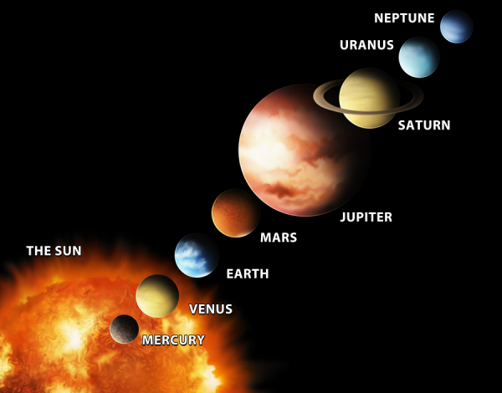
Comparing Planets
Ms. Edwards

Slide 2
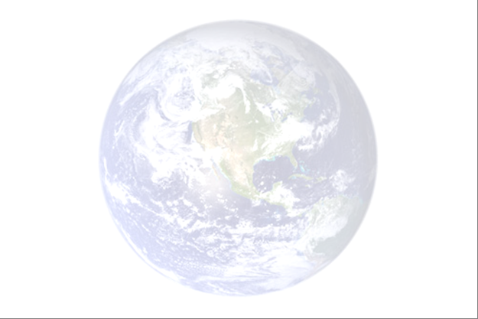
How does Earth compare to other planets in the solar system?
S6E1c. Compare and contrast planets in terms of: size relative to earth; surface and atmospheric features; relative distance from the sun; ability to support life
S6E1e. Explain that gravity is the force that governs the motion of the solar system
Notes:
Instructional Approach(s): The teacher should introduce the essential question and the standards aligned to the essential question.

Slide 3
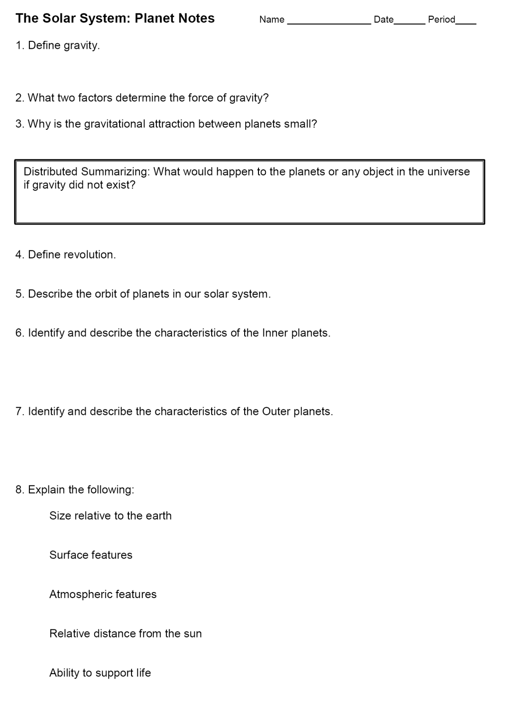
Use the Solar System Planet Notes to record important information.
Notes:
Instructional Approach(s): The teacher should give each student a Solar System Planet Notes sheet to use for recording the important facts about the planets.

Slide 4
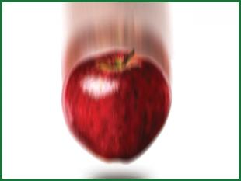
Gravity
The gravitational force of the
Sun keeps planets in orbit
around the Sun and controls
the rest of the motion of the
solar system.
The mass of an object and the distance between objects determine the force of gravity. Inertia and gravity work together.
The gravitational attractions of the planets, either individually or as a group are small because of the distances between the planets.
Notes:
Instructional Approach(s): The teacher can start by asking students “what is gravity?” and possibly “why is gravity important?”. Take 1-2 minutes to discuss gravity and then read through the information on the animated slide. Click on the word “Inertia” in the slide to go to a slide describing and providing images of inertia. Students should record important information on their notes.

Slide 5
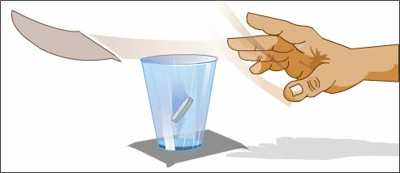
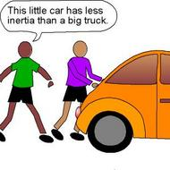
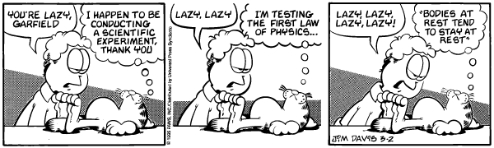
Inertia – the tendency of an object to resist being moved or, if the object is moving, to resist a change until an outside force acts on the object.

Slide 6
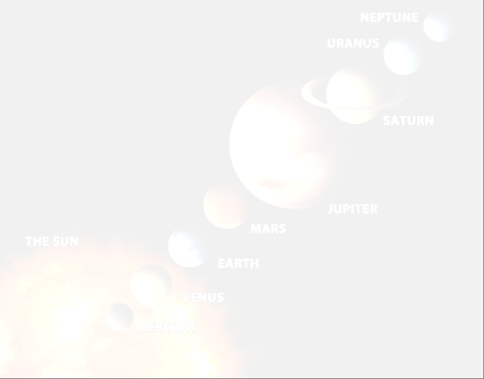
Study Jams Video:
Gravity & Inertia
Notes:
Instructional Approach(s): Show the short video on Gravity and Inertia

Slide 7
The Solar System
Revolution (revolve) is orbiting around another body
Planets in our solar system revolve around the sun in elliptical (oval) orbits.
The planets in our solar system differ in size, composition (rock or gas), surface and atmospheric conditions, and distance from the sun.
Notes:
Instructional Approach(s): The teacher should read the bulleted information to the class. After bullet two, the teacher should select one of the linked animations to show the planets revolving around the Sun. Students should record important information on their notes.

Slide 8
The Solar System
The planets are divided into two groups
  The inner planets are smaller, closer to the sun, and have rocky surfaces (Mercury, Venus, Earth, Mars)
  The outer planets are larger, farther from the sun and do not have solid surfaces (Jupiter, Saturn, Uranus, Neptune)
Notes:
Instructional Approach(s): The teacher should read the first bullet “the planets are divided into two groups”. Ask students if they know the two groups. If so, what is different about the two groups. If the students cannot quickly come up with the two groups of planets, go to the next two bullets. Students should record important information on their notes.

Slide 9
Use the Planet Comparison Chart to take notes about each Planet in the Solar System.
Notes:
Instructional Approach(s): The teacher should give each student a Planet Comparison Chart to use for recording the important facts about the planets.

Slide 10
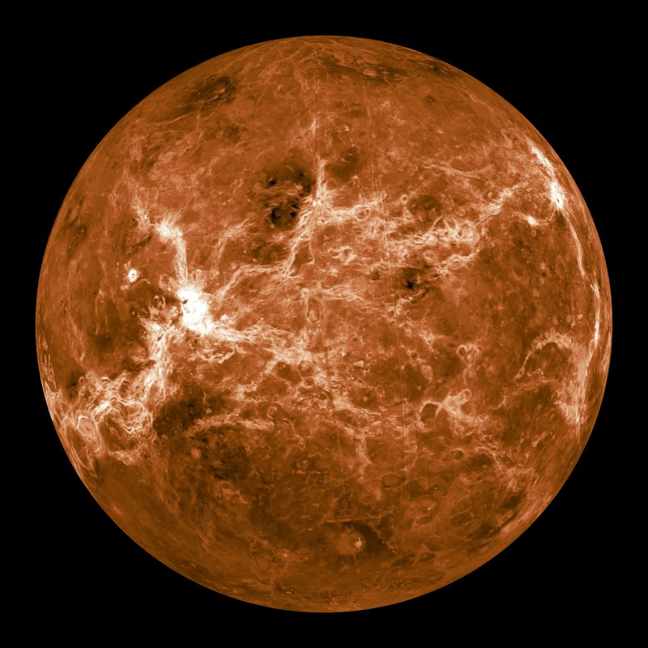
Mercury
Notes:
Instructional Approach(s): Introduce Mercury

Slide 11
Mercury
Size relative to earth: smaller than earth
Surface features: many craters and high cliffs
Atmospheric features: no atmosphere
Relative distance from the sun: closest planet to the Sun
It cannot support life
Other facts: Inner planet; has no moons; “earth-like” characteristics
Notes:
Instructional Approach(s): The teacher should read through each characteristic while the students record the information on the Planet Comparison Chart.

Slide 12
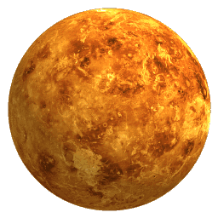
Venus
Notes:
Instructional Approach(s): Introduce Venus

Slide 13
Venus
Size relative to earth: Close to the earth’s size
Surface features: Hottest planet (can melt lead)
Atmospheric features: Contains Carbon dioxide (CO₂)
Relative distance from the sun: Second planet from the sun
It cannot support life
Other facts: Inner planet; sometimes called Earth’s twin because of its “earth-like” characteristics; a day is longer than a year due to its slow spin; spins clockwise; brightest object in the sky after the sun and moon
Notes:
Instructional Approach(s): The teacher should read through each characteristic while the students record the information on the Planet Comparison Chart.

Slide 14
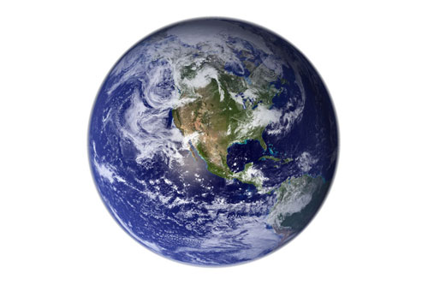
Earth
Notes:
Instructional Approach(s): Introduce Earth

Slide 15
Earth
Surface features: Has canyons, craters, mountains, volcanoes; more than 70% of the surface is covered by water
Atmospheric features: Contains Oxygen (O₂) and Nitrogen (N₂)
Relative distance from the sun: Third planet from the sun
Only planet known to support life
Other facts: Inner planet; Has one moon
Notes:
Instructional Approach(s): The teacher should read through each characteristic while the students record the information on the Planet Comparison Chart.

Slide 16
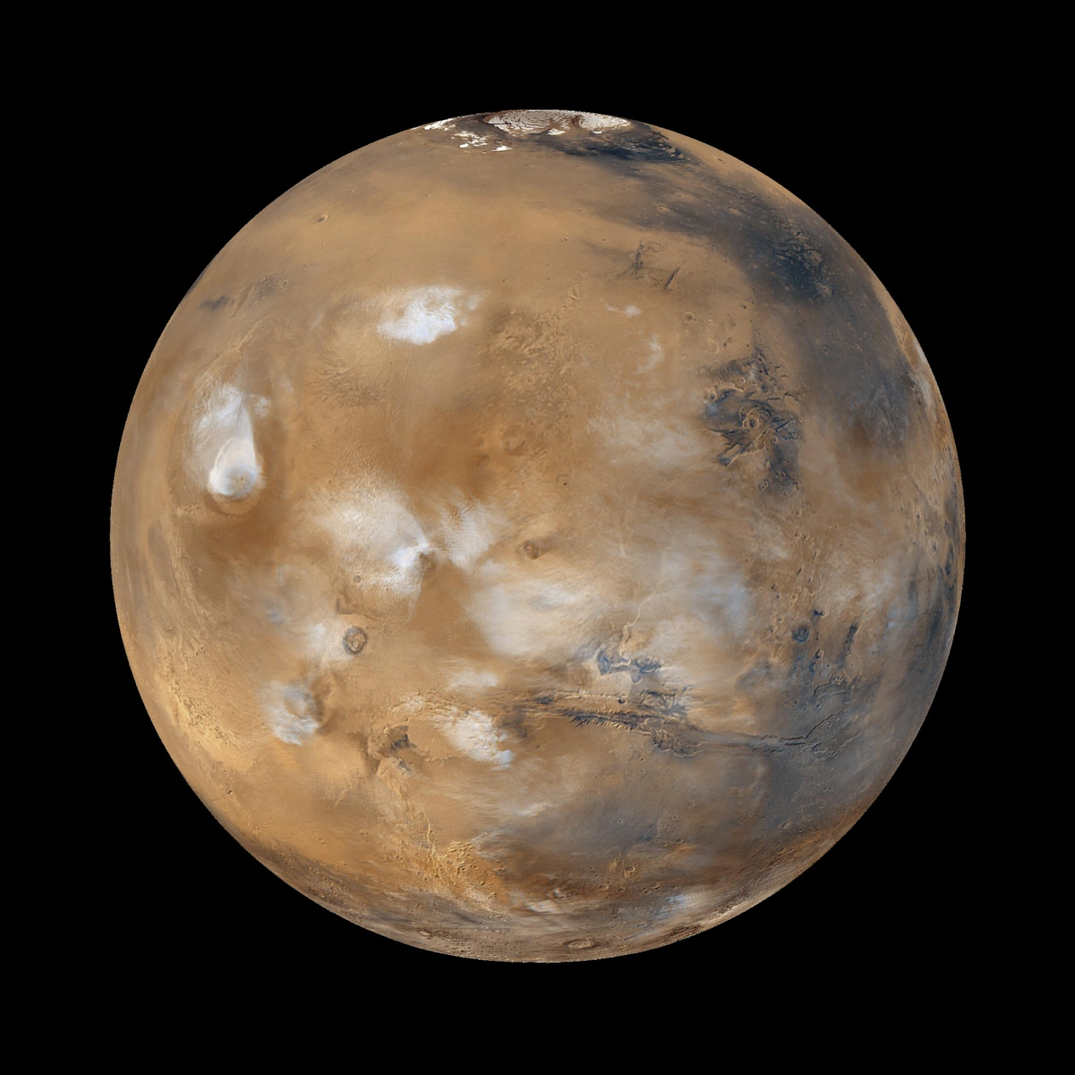
Mars
Notes:
Instructional Approach(s): Introduce Mars

Slide 17
Mars
Size relative to earth: Smaller in size than the earth
Surface features: “earth-like” characteristics; all water is frozen; once had active volcanoes
Atmospheric features: Thinner atmosphere than earth made mostly of carbon dioxide (CO₂)
Relative distance from the sun: Fourth planet from the Sun
It cannot support life
Other facts: Inner planet; called the red planet because of rusted soil; has severe dust storms at hurricane speed
Notes:
Instructional Approach(s): The teacher should read through each characteristic while the students record the information on the Planet Comparison Chart.

Slide 18
Study Jams Video:
Inner Planets
Notes:
Instructional Approach(s): Students should watch the short video summarizing the Inner Planets.

Slide 19
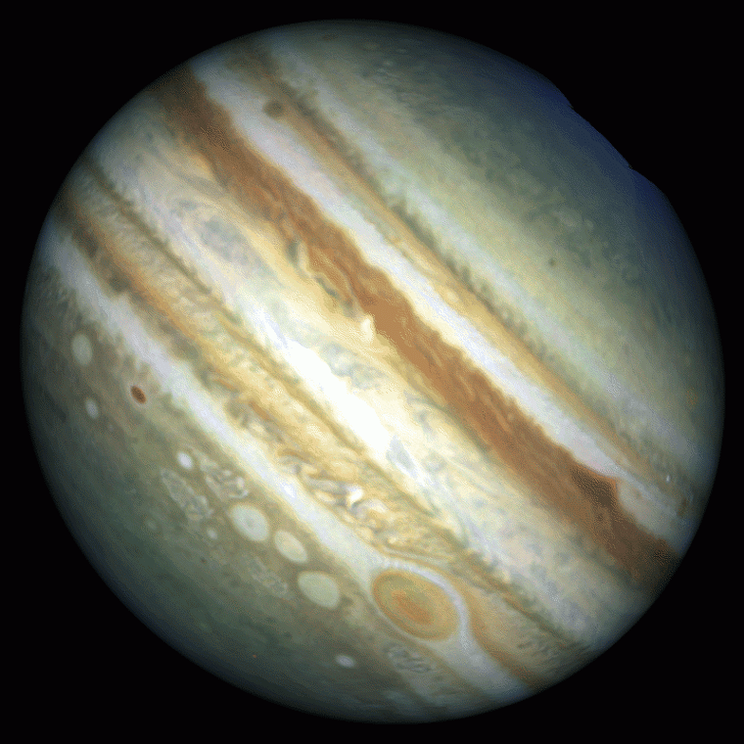
Jupiter
Notes:
Instructional Approach(s): Introduce Jupiter

Slide 20
Jupiter
Size relative to earth: Larger than the earth
Surface features: Gaseous planet
Atmospheric features: Contains mostly Hydrogen (H₂) and Helium (He)
Relative distance from the sun: Fifth planet from the Sun
It cannot support life
Other facts: Outer planet; largest planet; faint ring of dust; spins the fastest; has 63 moons; has a large red spot
Notes:
Instructional Approach(s): The teacher should read through each characteristic while the students record the information on the Planet Comparison Chart.

Slide 21
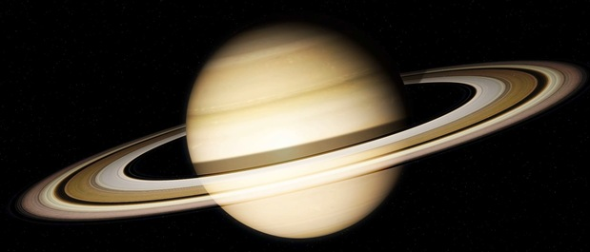
Saturn
Notes:
Instructional Approach(s): Introduce Saturn

Slide 22
Saturn
Size relative to earth: Larger than earth
Surface features: Surface is fluid; it is the least dense planet
Atmospheric features: Contains mostly Hydrogen (H₂) and Helium (He)
Relative distance from the sun: Sixth planet from the Sun
It cannot support life
Other facts: Outer planet; Gaseous planet; 1 year equals 29 ½ Earth years; Largest, most impressive ring system; Second largest planet in the solar system
Notes:
Instructional Approach(s): The teacher should read through each characteristic while the students record the information on the Planet Comparison Chart.

Slide 23
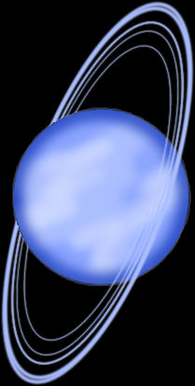
Uranus
Notes:
Instructional Approach(s): Introduce Uranus

Slide 24
Uranus
Size relative to earth: Larger than earth
Surface features: planet of ice and gas so it really does not have a surface (you would sink into the liquid icy center)
Atmospheric features: Contains mostly Hydrogen (H₂), Helium (He), and Methane (CH₄)
Relative distance from the sun: 7th planet from the Sun
It cannot support life
Other facts: Gaseous planet; Third largest planet; Tipped on its side
Notes:
Instructional Approach(s): The teacher should read through each characteristic while the students record the information on the Planet Comparison Chart.

Slide 25
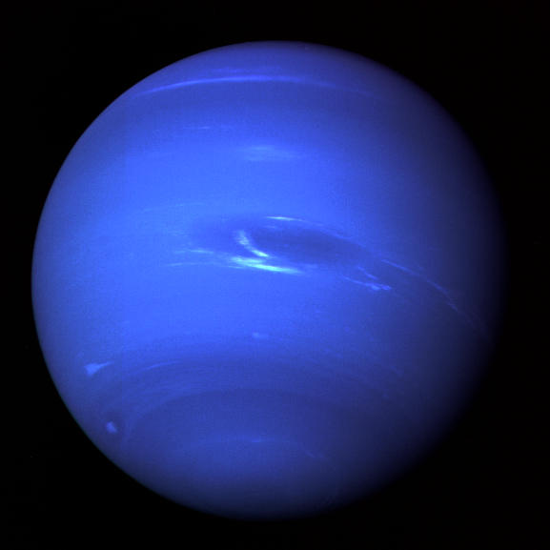
Neptune
Notes:
Instructional Approach(s): Introduce Neptune

Slide 26
Neptune
Size relative to earth: Larger than earth
Surface features: Coldest planet and has large storm systems like the Great Dark Spot; not a solid surface
Atmospheric features: Methane (CH₄)
Relative distance from the sun: 8th planet from the sun
It cannot support life
Other facts: Outer planet; Gaseous planet
Notes:
Instructional Approach(s): The teacher should read through each characteristic while the students record the information on the Planet Comparison Chart.

Slide 27
Study Jams Video:
Outer Planets
Notes:
Instructional Approach(s): Students should watch the short video summarizing the Outer Planets.

Slide 28
Summarizing Strategy: Comparing Planets Graphic Organizer
Notes:
Instructional Approach(s): The summarizing strategy should be completed by each student individually. The teacher should evaluate each student’s summarizer to determine his/her level of mastery. In this summarizer, students must provide characteristics of the Earth and at least four other planets of their choosing.

